Slide 1
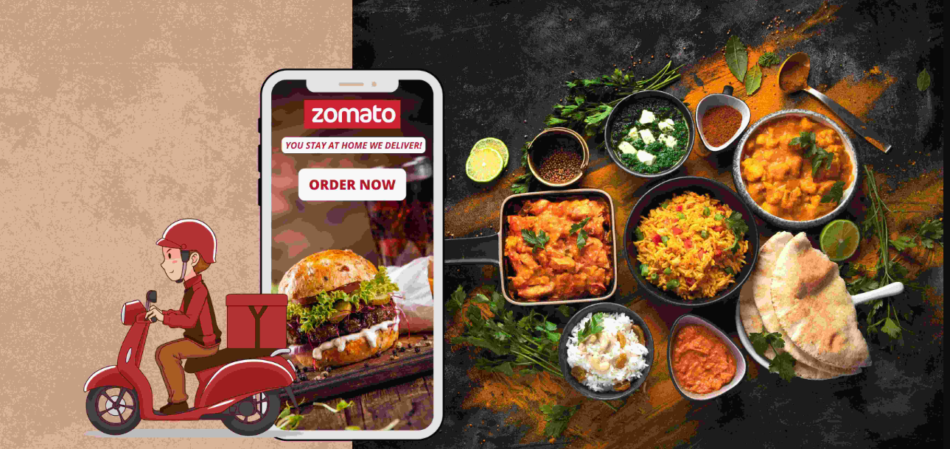
Zomato Analytics Project Analysis of Restaurant Data Across Various Dimensions

Slide 2
INTRODUCTION
Objective: "To provide an analytical overview of Zomato's restaurant data, including distribution by city, cuisine, ratings, and more.
Agenda:
Overview of Key Metrics
Distribution Analysis
Rating Analysis
Cuisine Analysis
Conclusion

Slide 3
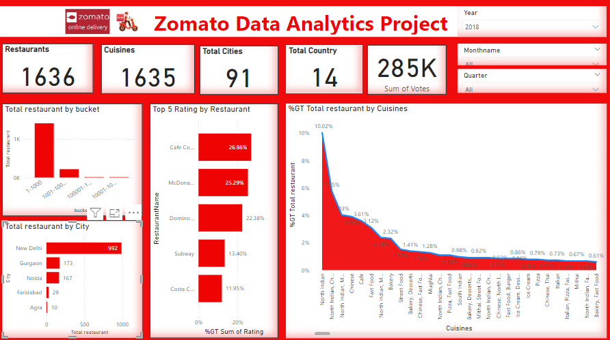
Key Metrics Overview
Total Restaurants: 1636
Total Cuisines: 163
Total Cities: 91
Total Countries: 14
Sum of Votes: 285K

Slide 4
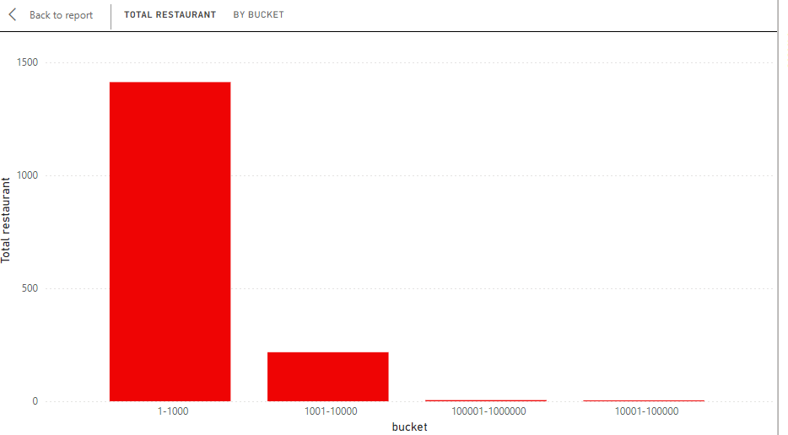
Total Restaurant Distribution by Bucket
Embed the bar chart showing the total number of restaurants by bucket.
Explain the distribution of restaurants based on their bucket categories, highlighting any significant observations.

Slide 5
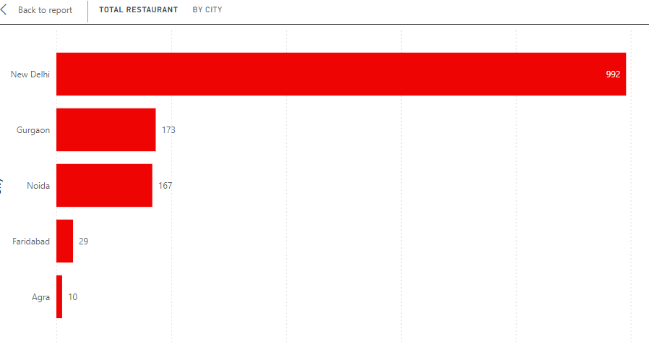
Total Restaurants by City
Embed the bar chart showing the total number of restaurants in each city.
New Delhi has the highest number
of restaurants (992).
Other notable cities include Gurgaon (173)
Noida (167), Faridabad (29), and Agra (10).
Discuss possible reasons for high
concentration in these cities.

Slide 6
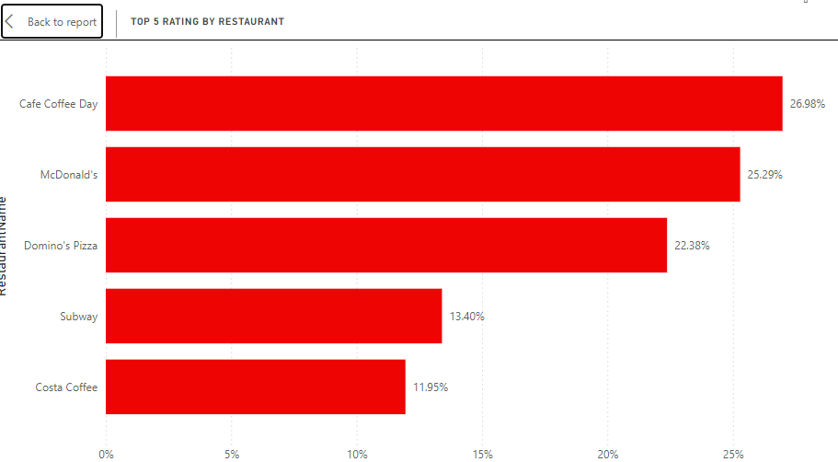
Top 5 Ratings by Restaurant
Embed the bar chart showing the top 5 restaurants by rating
Cafe Coffee Day: 26.98%
McDonald's: 25.29%
Domino's Pizza: 22.36%
Subway: 13.40%
Costa Coffee: 11.95%
Discuss the high ratings of these
restaurants and potential factors
contributing to their popularity.

Slide 7
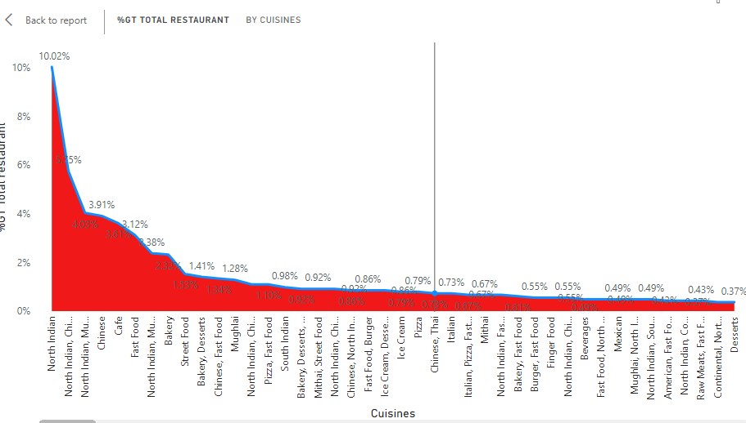
Percentage of Total Restaurants by Cuisines
Embed the graph showing the percentage of total restaurants by cuisine type.
North Indian cuisine is the most popular (10.02%).
Other notable cuisines include
Chinese (7.34%), Fast Food (6.31%), etc.
Discuss trends and popularity
of various cuisines.

Slide 8
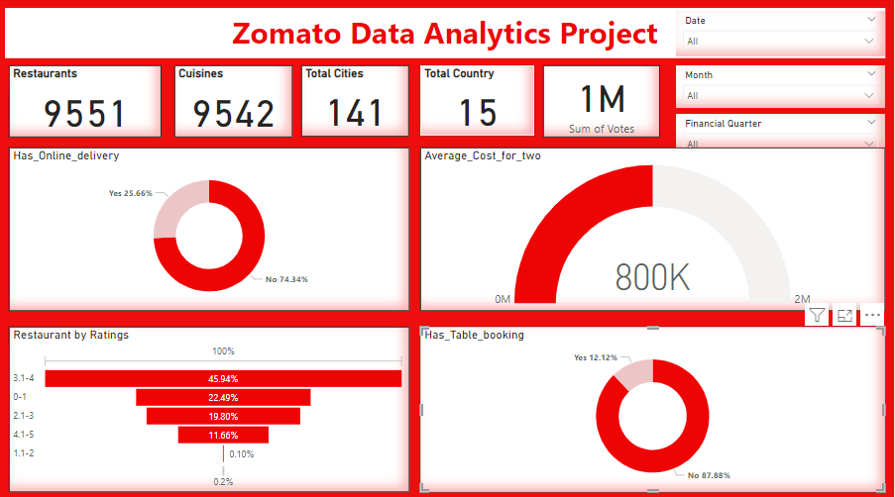
Key Metrics Overview
Total Restaurants: 9551
Total Cuisines: 9542
Total Cities: 141
Total Countries: 15
Sum of Votes: 1M

Slide 9
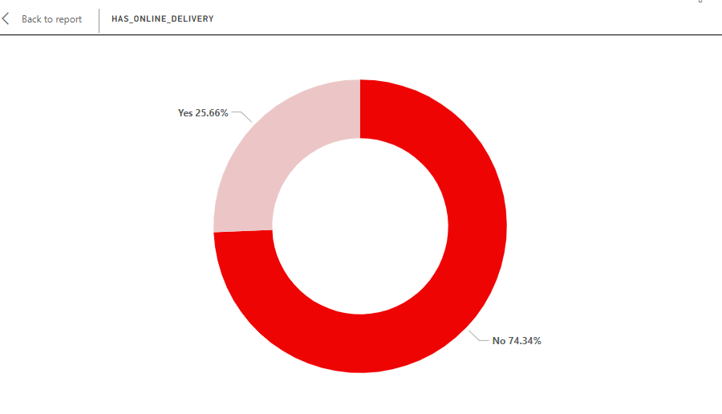
Online Delivery Analysis
Embed the donut chart showing the percentage of restaurants with online delivery
Yes: 25.66%
No: 74.34%
Discuss the significant majority of restaurants
that do not offer online delivery, potential
reasons, and implications for business strategy.

Slide 10
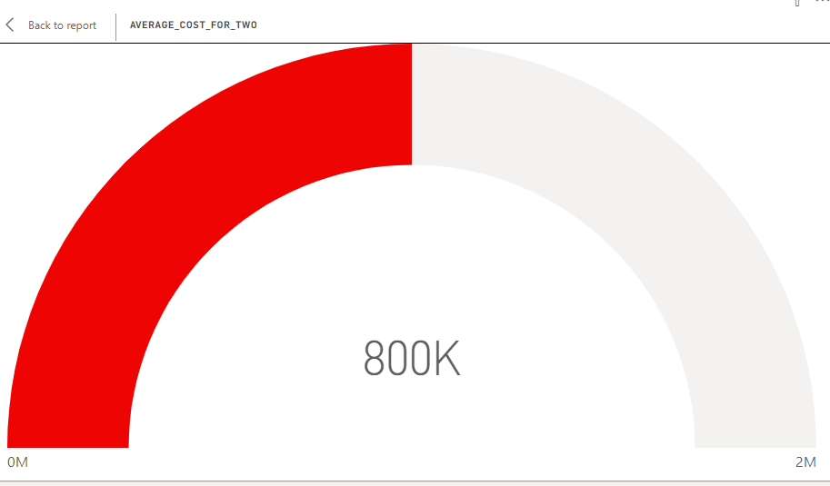
Average Cost Analysis
Embed the gauge chart showing the average cost for two, which is around 800K
Provide insights on the average
dining cost and how it
compares across different
cities or regions.

Slide 11
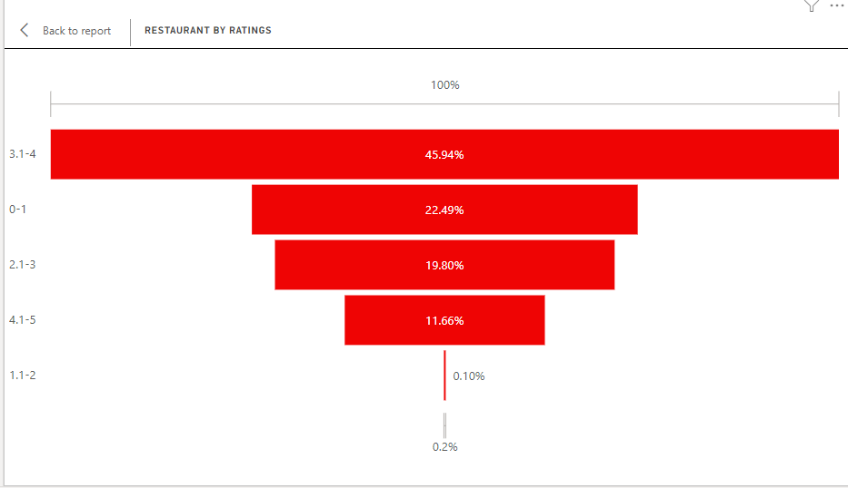
Rating Distribution
Embed the bar chart showing the distribution of restaurant ratings
3.1-4: 45.94%
0-1: 22.49%
2.1-3: 19.80%
1.1-2: 11.66%
4.1-5: 0.2%
Explanation: Analyze the distribution
of ratings, highlighting that
the majority of restaurants fall in
the 3.1-4 rating range.
Discuss the implications for quality
and customer satisfaction.

Slide 12
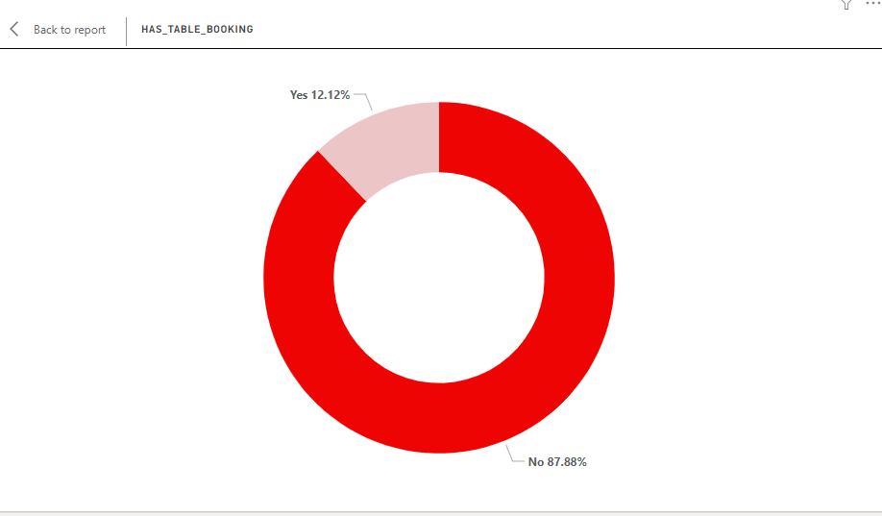
Table Booking Analysis
Embed the donut chart showing the percentage of restaurants with table booking.
Yes: 12.12%
No: 87.88%
Discuss the low percentage
of restaurants offering table
booking and its potential impact on
customer experience and
restaurant operations.

Slide 13
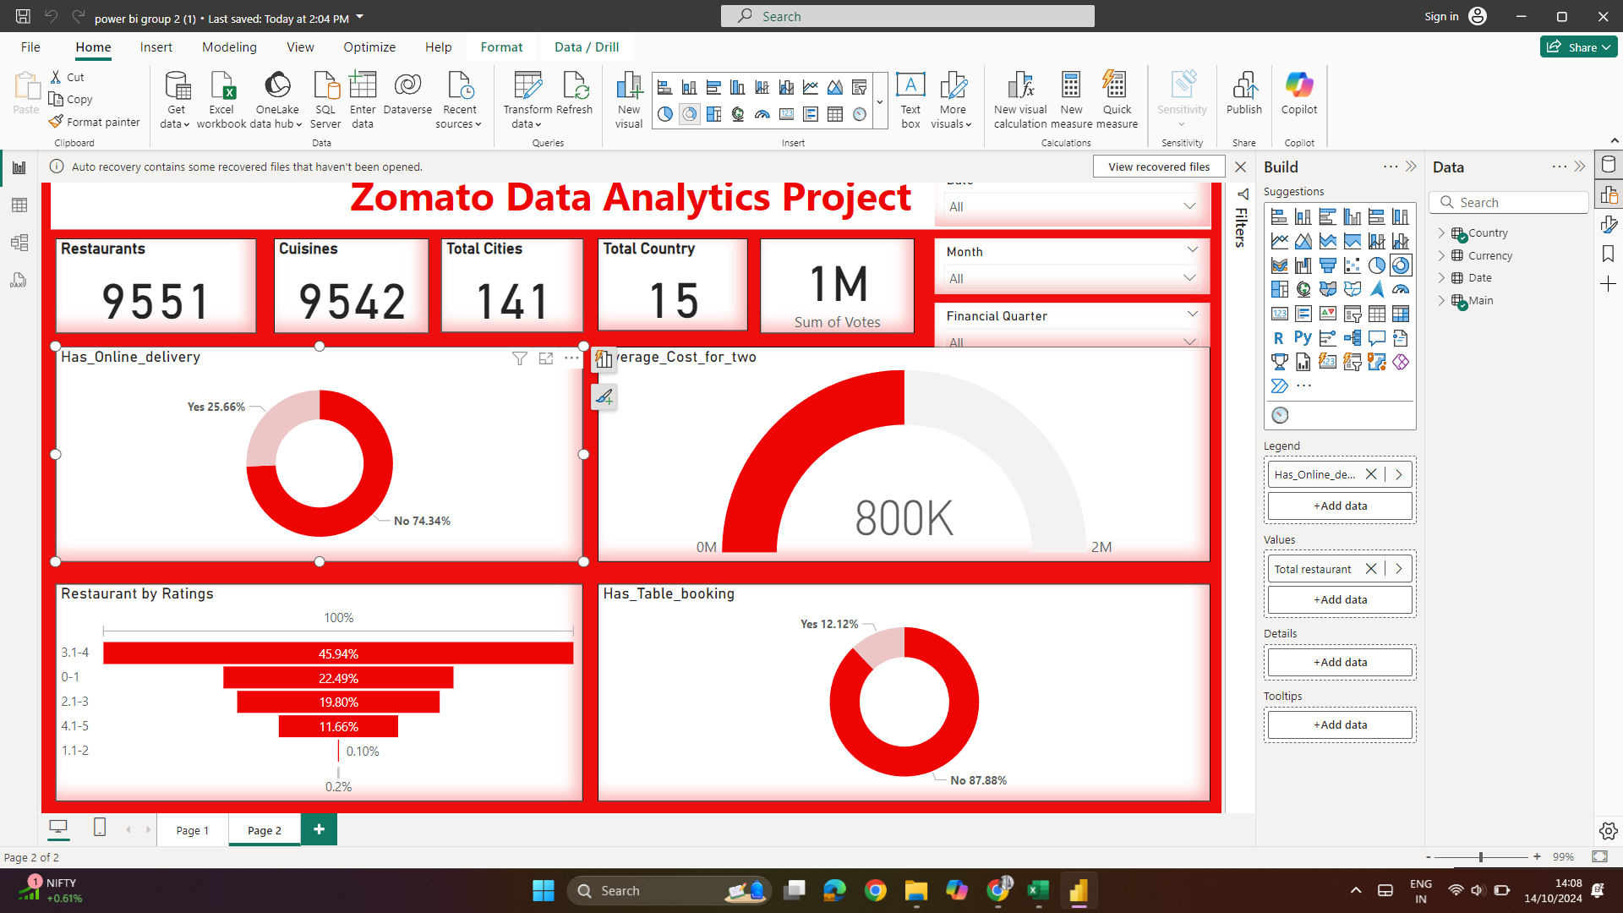
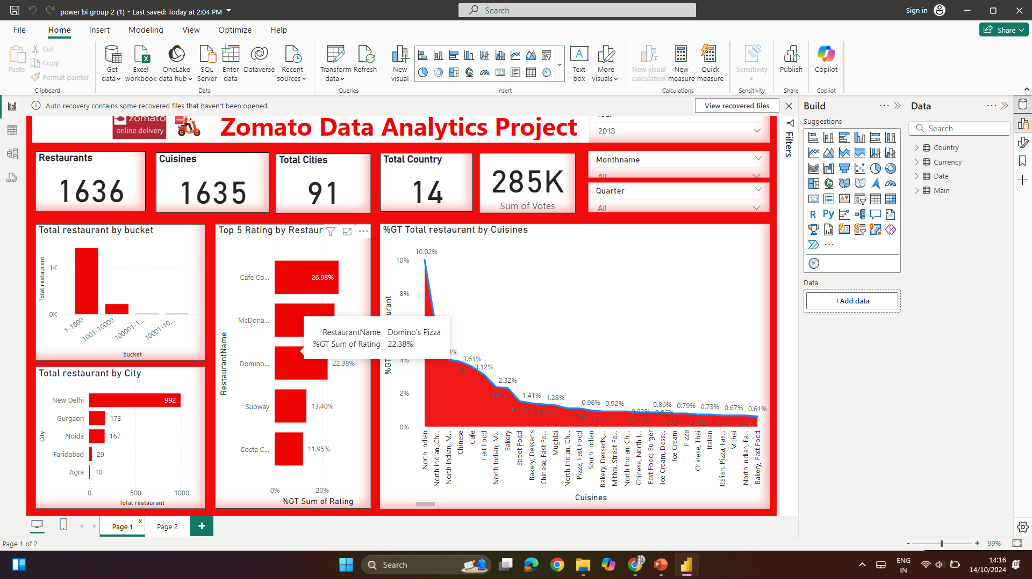

Slide 14
Conclusion
Key metrics provide an overview of Zomato's extensive restaurant network.
Significant concentration of restaurants in major cities like New Delhi.
Popularity of certain cuisines and highly-rated restaurants.
Insights can be valuable for restaurant owners, marketers, and Zomato for strategic planning.
Explore further dimensions like customer reviews, seasonal trends, and impact of promotions.
The majority of restaurants do not offer online delivery.
Average cost for two people is around 800K.
Most restaurants have ratings between 3.1 and 4.
Table booking is available in a small percentage of restaurants
Potential areas for improvement in online delivery and table booking services.
Understanding customer preferences based on ratings and costs.
Explore deeper into customer reviews, seasonal trends, and the impact of promotions.

